Slide 1

Impact of Iron Ore Price on Property Price in Perth & Sydney
Group Members:
Shreestina Tamrakar
Dion Daniels
Musah Abdulai

Slide 2
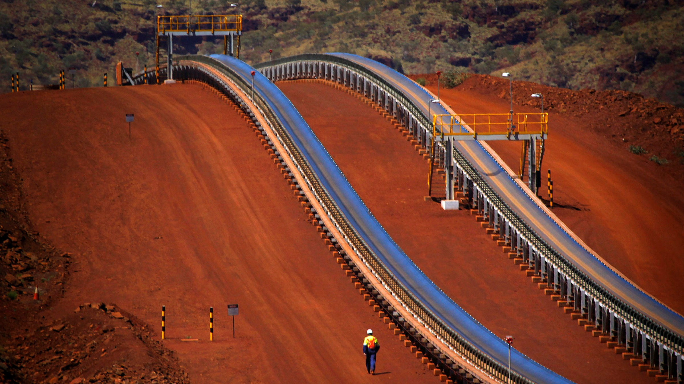
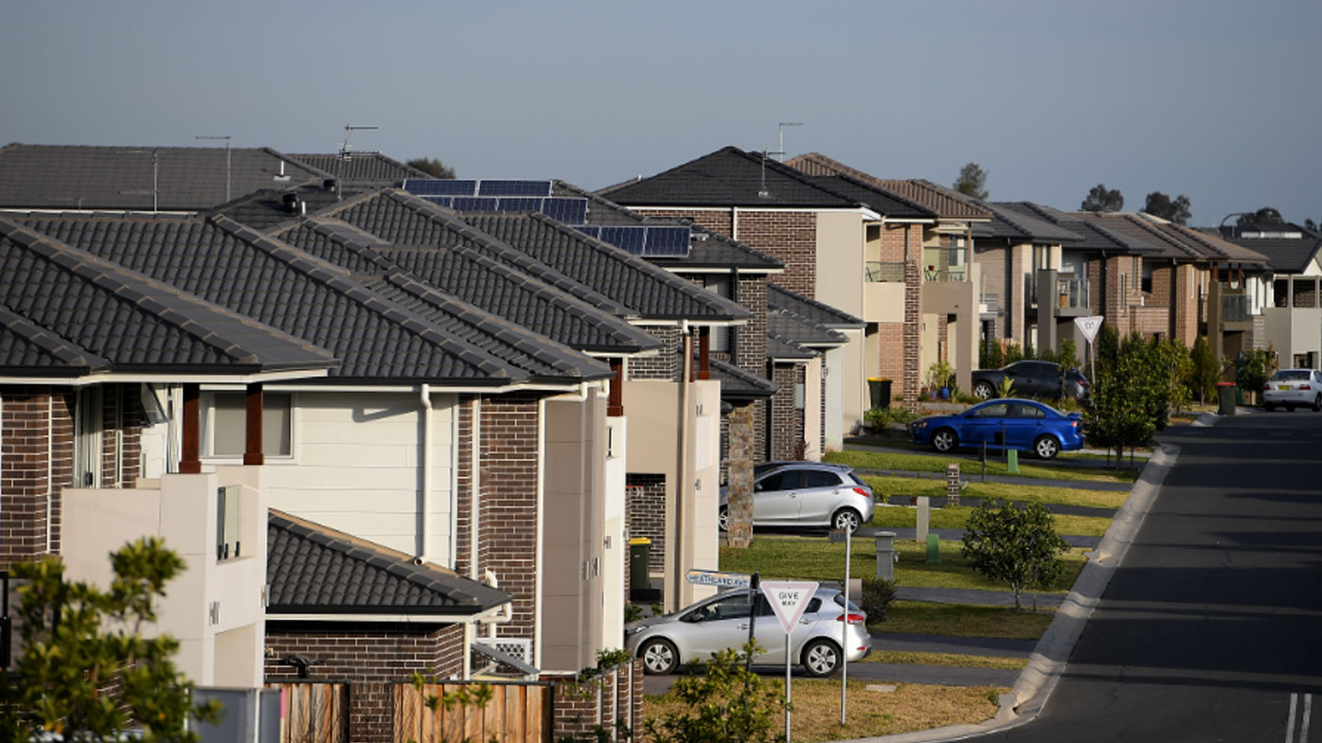
Summary
Iron ore is a dominant force in Australia’s economy and the reliance on iron ore will likely continue in the foreseeable future, despite other commodities such as gold, nickel etc, could be on a high move. A sharp increase iron price could translate into an increase in house prices. But is this a proof of a relationship? (Property Tribune 2021).

Slide 3
Why Iron Price & House Price?
“From Australian Bureau of Statistics (ABS) commodity price index increased 3.1% on a monthly average basis” while “CoreLogic national property index, recorded that the average dwelling prices increased +2.8% and +1.8% in March and April 2021”.
Our team aim to study the relationship between the iron ore and house price.
We investigated the data for iron ore and house price in Perth and Sydney from 2008 to 2018
Null Hypothesis: There is no correlation between iron ore and house price.
Alternative Hypothesis: There is a correlation between iron ore and house price (in Perth & Sydney).

Slide 4
Research Questions
Is there increase or decrease in iron ore prices over the years?
Is there increase or decrease in house prices over the years?
Is the variation between Perth and Sydney?
Is there a correlation between house prices and iron ore price?

Slide 5
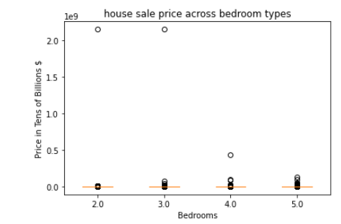
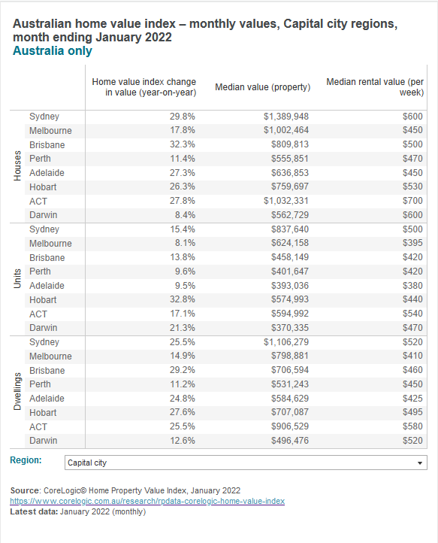
Data Collection and Limitations
Perth and Sydney housing data:
Source - Kaggle
Limitations:
- Data is generated from users limiting reliability
- Data generated from web scraping limiting accuracy
Commodities data:
Source - Market Index
Limitations:
- Prior to 2008 Iron ore price was recorded yearly

Slide 6
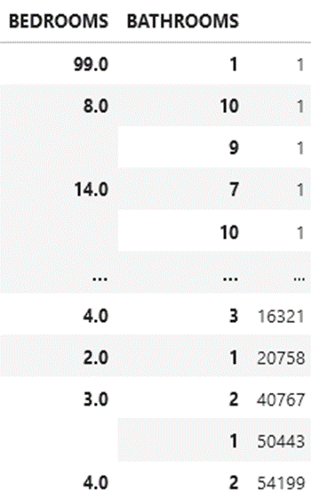
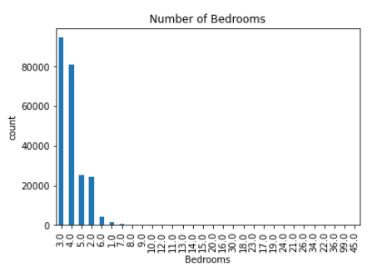
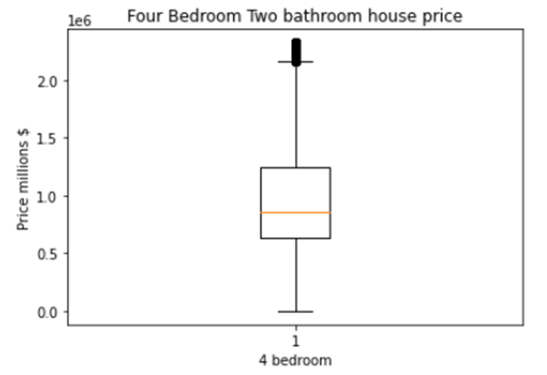
Data Cleanup & Exploration
Data Cleanup:
Clean data
remove any missing
Fixed data dates to pandas date format
and reformatted to quarterly data
Limit dataframe to parameters of interest
Select a control
Calculate the IQR and determine if there are any potential outliers.
Used plotting and statistics functions

Slide 7
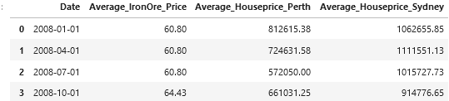
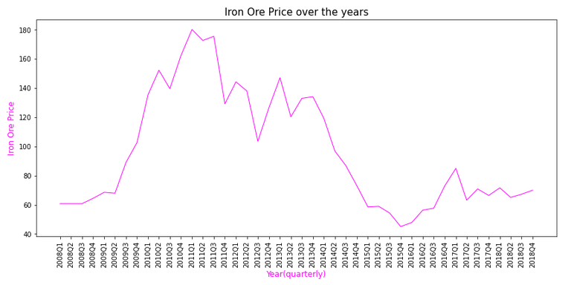
Data Analysis
Dataframe further narrowed down for analysis
Q1: Is there increase or decrease in iron ore prices over the years?
The iron price was around $60 in 2008 and within three years (i.e. 2011) had soared to almost $180
The price fluctuated after 2011 and dropped significantly to below $60 by 2015
The price stabilised after 2015 with slight rise until 2018

Slide 8
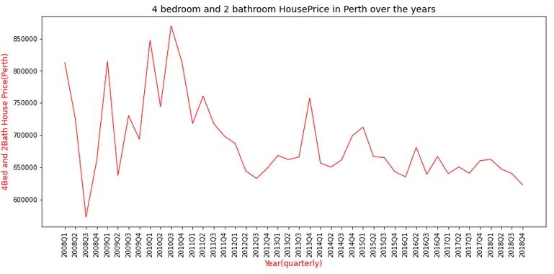
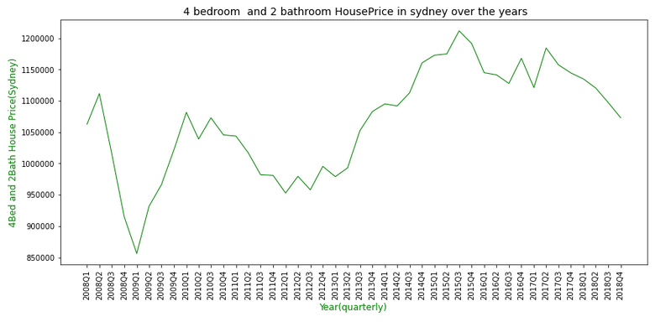
Data Analysis…
Q2: Is there increase or decrease in house prices over the years?
Perth
Sydney
Drastic dropped in price during 2008 below $600k from the average price of $800k
Price started increasing after 2008 and reached to high point of above $850k
Price continued to drop from 2011 and fluctuated further with slight increase and decrease
Price started decreasing from 2008 and plummeted in 2009
Price increased from 2009 further and skyrocketed above $1.2 million
By 2018, price dropped slightly but still above $1 million

Slide 9
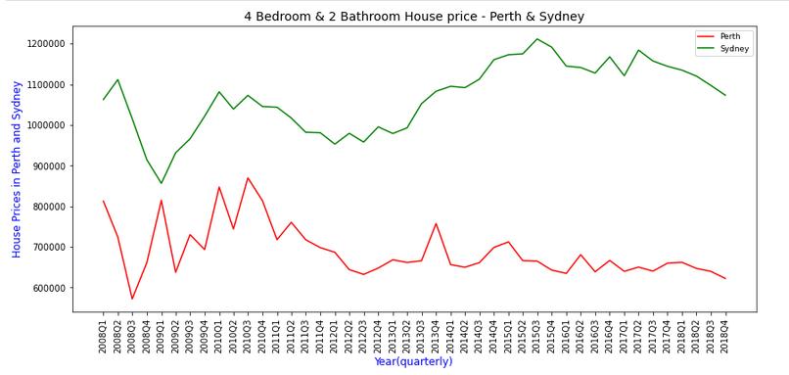
Data Analysis…
Q3: Is there variation between Perth and Sydney?
House prices in Sydney are consistently higher than Perth
Prices plunged during 2008
From the start of 2012, prices in Perth slightly decrease over time with a few fluctuations whereas it seems to increase gradually in Sydney

Slide 10
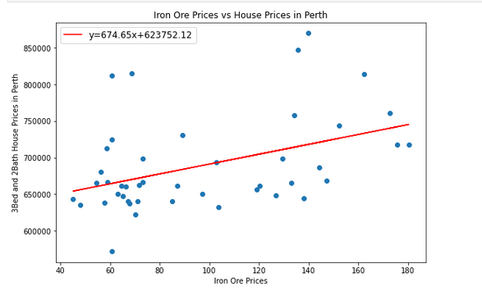
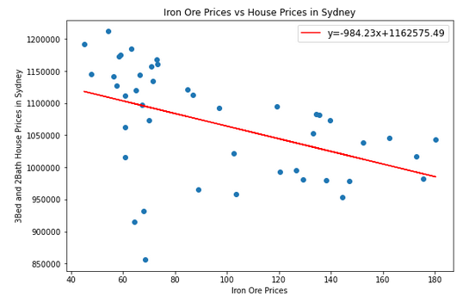
Data Analysis…
Q4: Is there a correlation between house prices and iron ore price
We plotted regression line for Perth and Sydney versus Iron Ore Price and calculated Pearson’s coefficient
Perth – The correlation coefficient of 0.42 shows a moderate positive correlation between iron ore price and house price
Sydney – The correlation coefficient of -0.46 shows a moderate negative correlation between iron ore price and house price
r = 0.42
r = -0.46

Slide 11
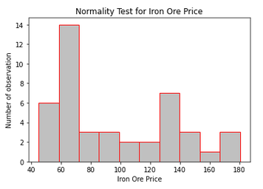
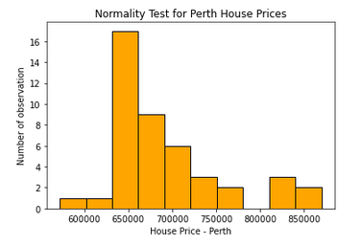
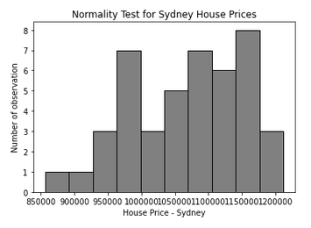
Data Analysis…
Q4: Is there a correlation between house prices and iron ore price…
We analysed for normal distribution for Iron Ore Price, Perth and Sydney prior to T-Test for each
Normality test based on D’Agostino & Pearson that combines skewness and kurtosis
For iron ore price and Perth house prices, even though p value < 0.05 it is not normal due to shape
For Sydney house, even though p value > 0.05, graph shows it is not normal as bell shape cannot be formed
pvalue = 0.377
pvalue = 0.022
pvalue = 0.003

Slide 12
Data Analysis…
Q4: Is there a correlation between house prices and iron ore price…
Perth T-Test results
There is a statistically significant difference between iron ore price and house price, t = -71.151, p value <0.05
Hence, we reject the null hypothesis and accept the alternative hypothesis’ – i.e., there is a correlation between the iron ore price and house price
Sydney T – Test results
There is a statistically significant difference between iron ore price and house price, t = -83.438, p value <0.05
Hence there is a correlation between the iron ore price and house price as we reject the null hypothesis

Slide 13
Conclusion
House prices are higher in Sydney than in Perth
While housing prices increased with iron ore price in Perth, the case is opposite in Sydney – however the two cases showed a moderate correlation
From test of t-test we rejected the null hypothesis and accept that there is a correlation between iron ore prices and housing prices
this could be due to higher iron price allowing mining companies in WA to pay workers more enticing than those in other states to move over thereby putting pressure on housing market.
Likewise, if resident are leaving Sydney for higher pay positions, that takes off pressure on housing market in Sydney.

Slide 14
Questions?

Slide 15
Appendix – Data Sets
Market Index (Iron ore and commodity prices):
https://www.marketindex.com.au/iron-ore
Sydney house Prices:
https://www.kaggle.com/mihirhalai/sydney-house-prices
Perth House Price:
https://www.kaggle.com/syuzai/perth-house-prices
Goldman Sachs commodity index:
https://au.investing.com/indices/sp-gsci-commodity-total-return-historical-data

